Slide 1
MGMT 571 – Final Project
Regression Rhinos – Rank #4
Piyush Kakde, Pratik Mahesh Merchant, Priyam Sarkar

Slide 2



Meet our wonderful team!
Piyush Kakde
Pratik Mahesh Merchant
Priyam Sarkar

Slide 3
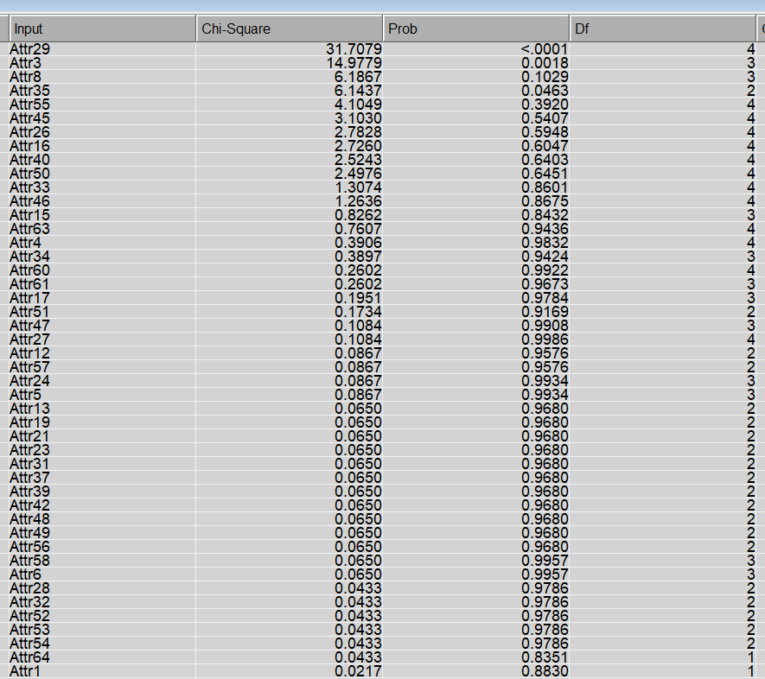
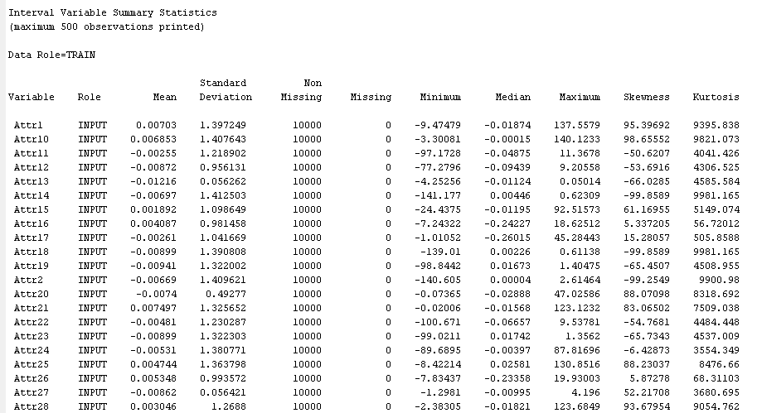
Exploratory Data Analysis (EDA) – Before Preprocessing
Chi Square Test
Summary Statistics

Slide 4
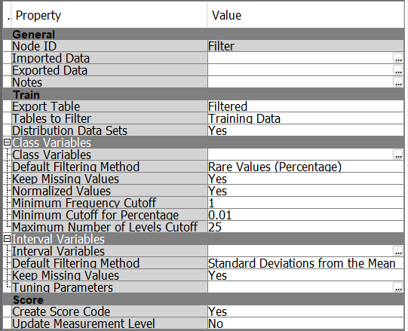
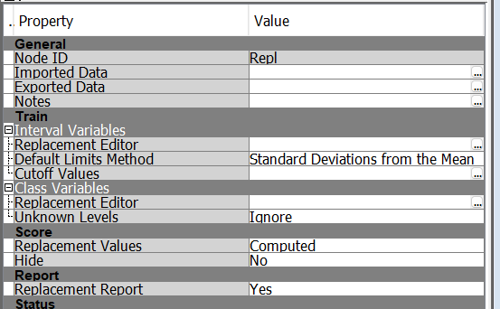
Preprocessing of Data
Filter Property Tab
Replacement Property Tab

Slide 5
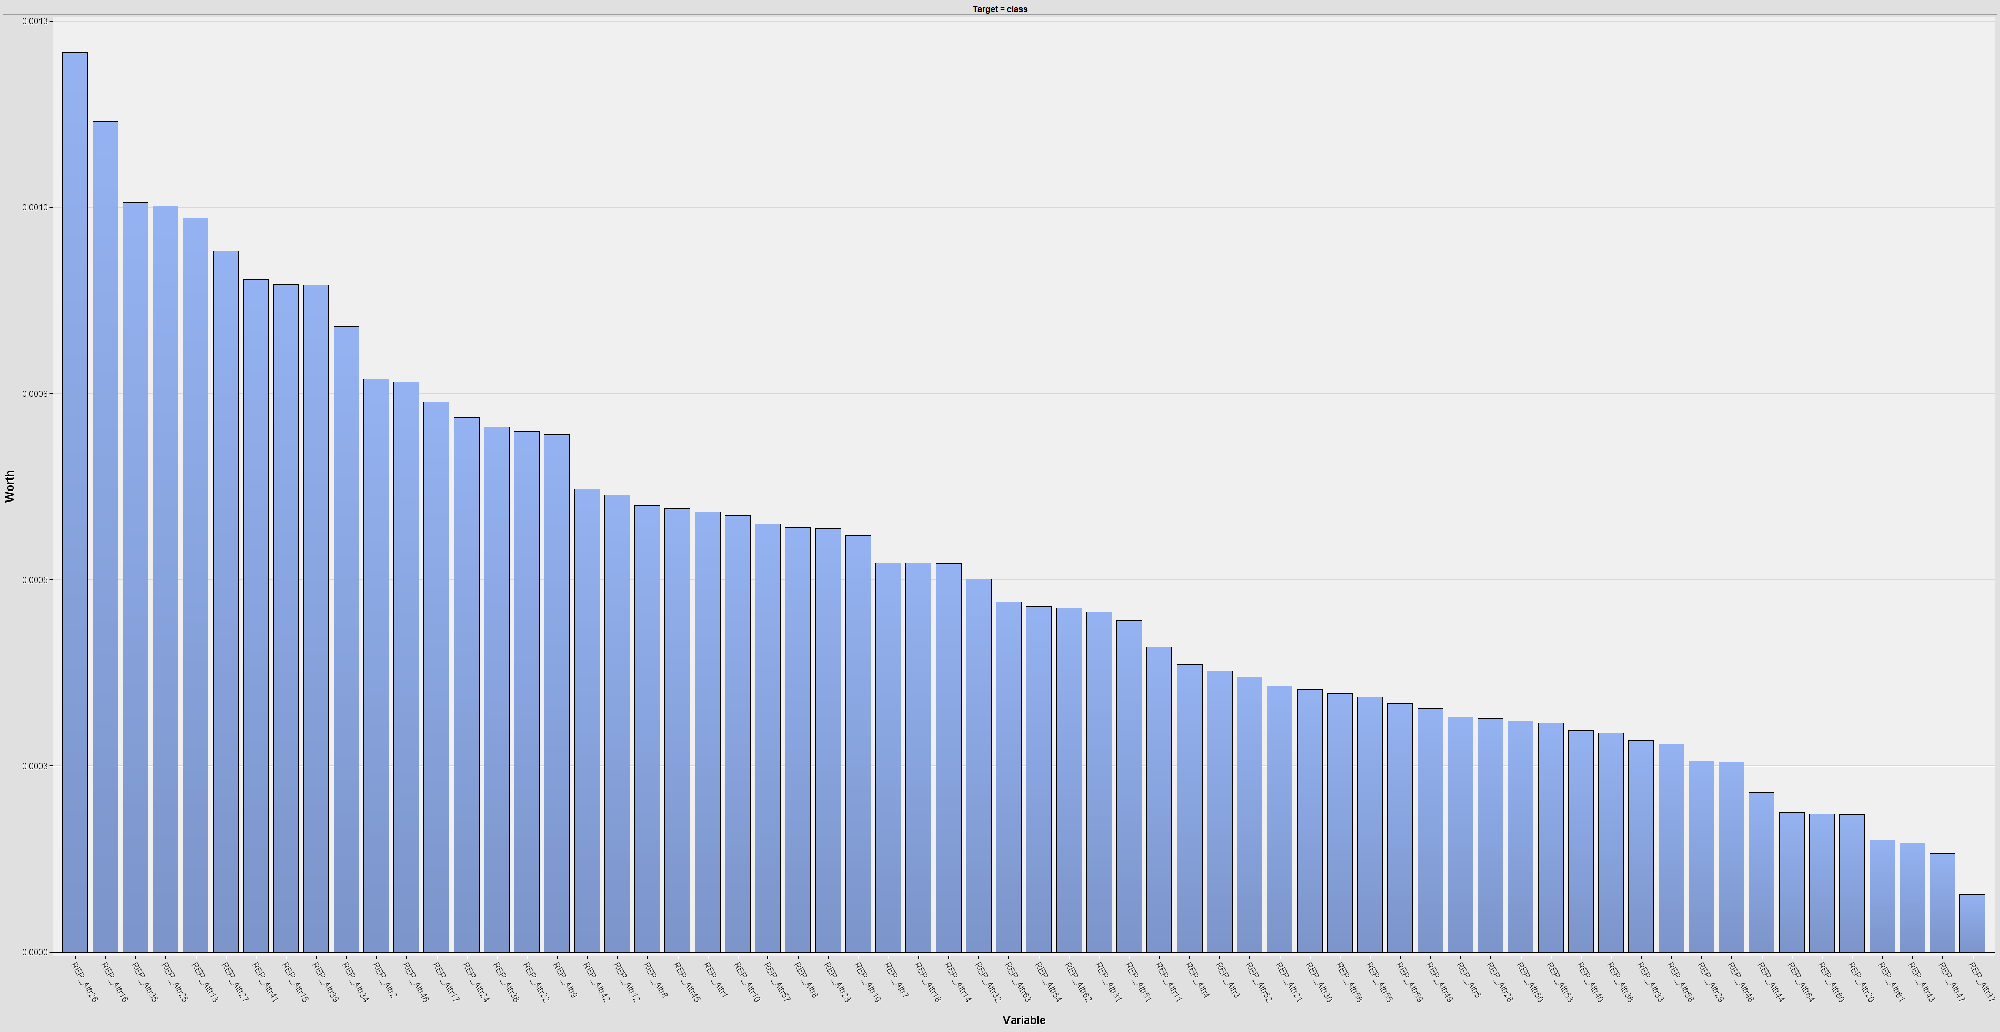
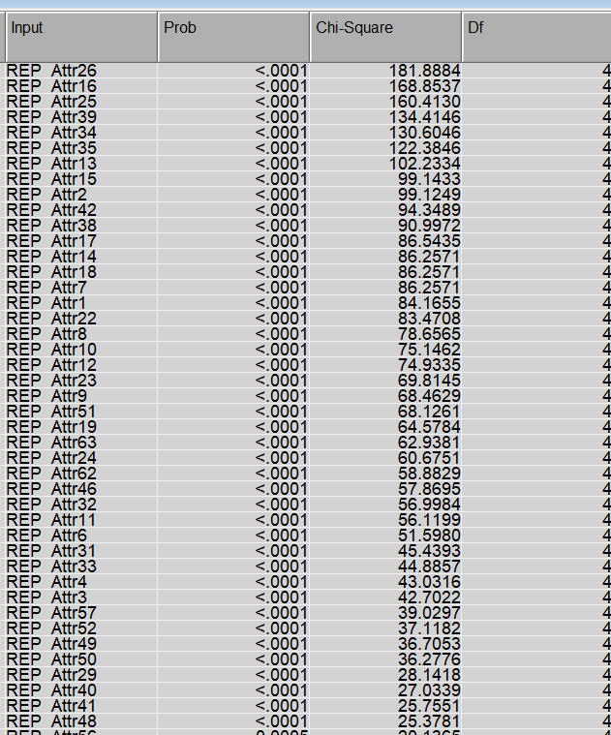
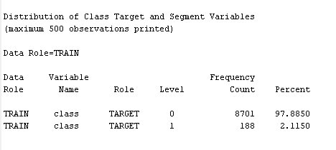
Exploratory Data Analysis (EDA) – After Preprocessing
Variable Importance
Chi Square Test
The Chi-square test reveals that a company's likelihood of bankruptcy is closely linked to a combination of its operational efficiency, profitability, liquidity, and leverage ratios.
Class Imbalance

Slide 6
Initial Approach
Single Data Partition
Data is divided into train and validation in 70:30 ratio.
4 Algorithms
Logistic Regression, Neural Network, Gradient Boosting, HP Neural Network.
Model resulted in low accuracy and a large difference in ROC between training set and validation set.

Slide 7
Next Steps
Data Partition
Applying Ensemble to these algorithms to obtain better predictive performance than could be obtained from any of the constituent learning algorithms alone.
Since SAS EM does not have a cross-validation feature, we somewhat replicated the feature using multiple data partitions.
Ensemble
Results slightly improved

Slide 8
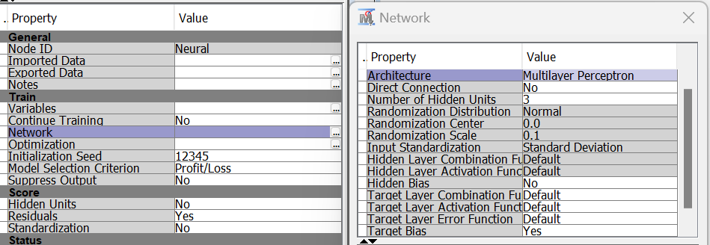
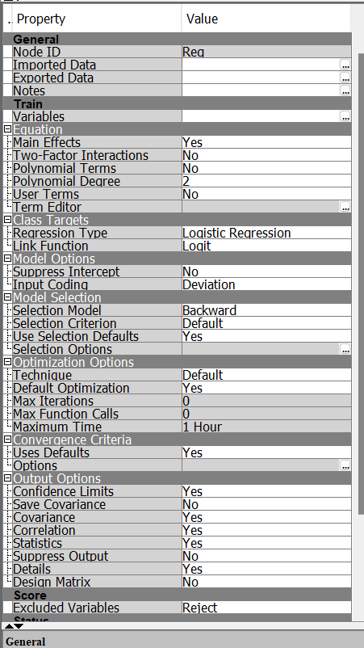
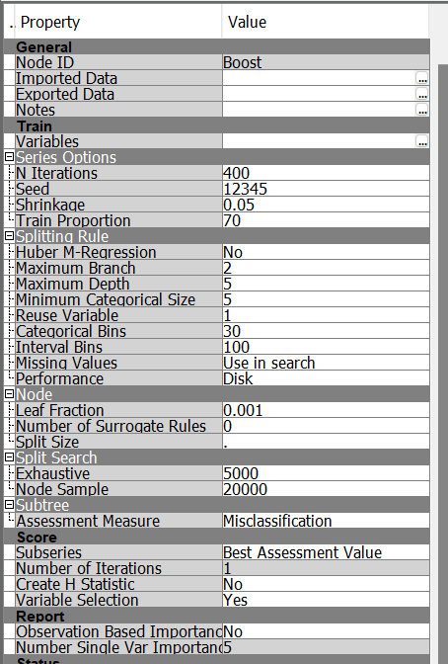
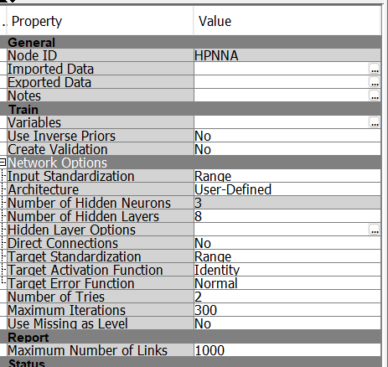
Model Parameters
Neural Network
Logistic Regression
Gradient Boosting
HP Neural Network

Slide 9
Final Model
4 Algorithms
Logistic Regression
Gradient Boosting
Neural Network
HP Neural Network
Ensemble all the algorithms
Filter
Ensemble all the previous ensemble
Replacement
Multiple Data Partitions
Model Comparison with ROC as criteria

Slide 10
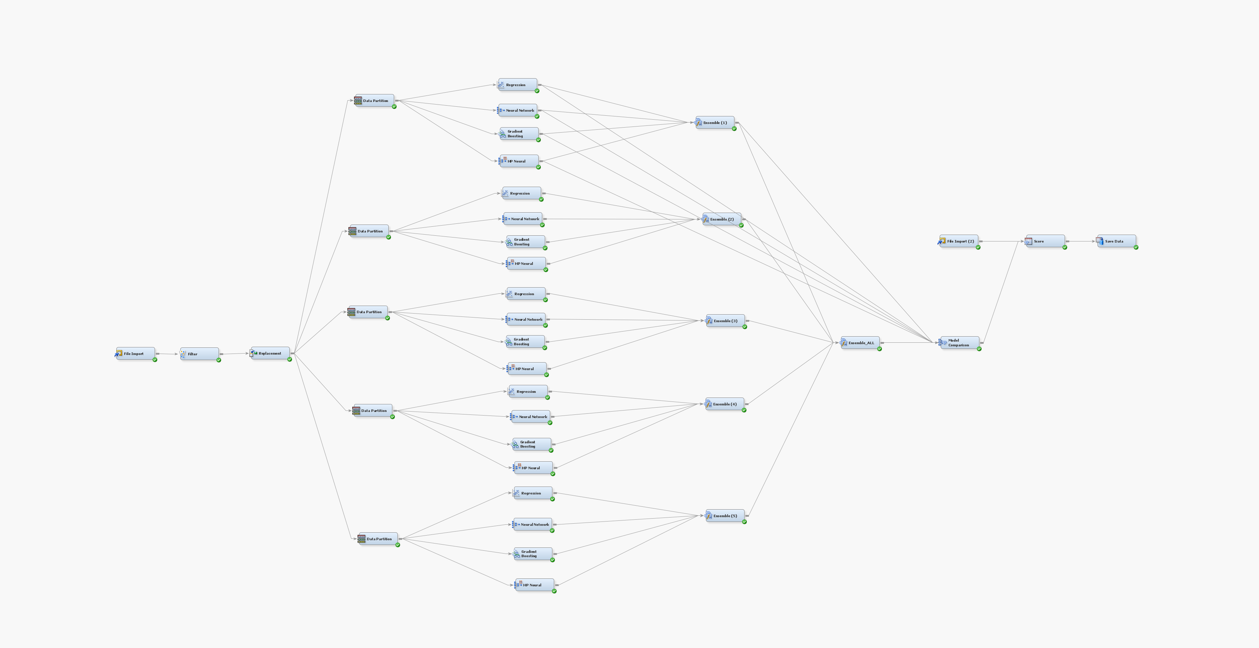
Final Model

Slide 11
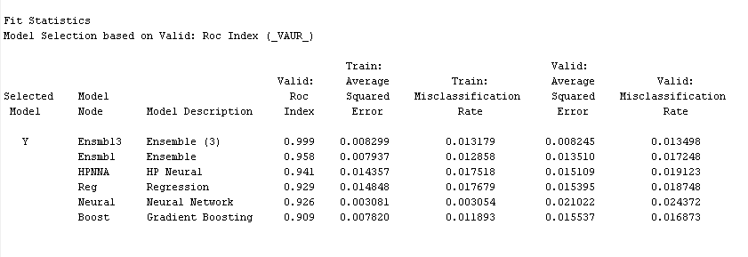
Results from Final Model
Leaderboard Scores:
Public: 0.95701
Private: 0.95331

Slide 12
Key Takeaways
When dealing with imbalanced datasets, evaluating model performance using the Receiver Operating Characteristic (ROC) curve is crucial for a more accurate assessment
Mixing up the data in different ways often helps the model do better when it's tested with new data
When the data has lots of complex patterns and uneven distributions, using Neural Networks or Gradient Boosting tends to work well
Simpler methods, like decision trees, usually don't do as well in these complex situations

Slide 13
Thank You!
Regression Rhinos

